Slide 1
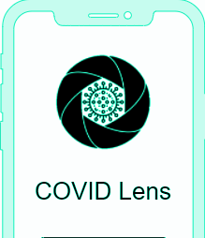
COVID Lens
Progress Report 1
Isaac Taylor, Mark He, Reagan Berhe, Seth Goodwin, Tammy Ogunkale

Slide 2
COVID Lens Application
Tables of Contents
Project Definition
Functional Requirements
Usability Requirements
System Requirements
User Requirements

Slide 3
COVID Lens Application
Tables of Contents
Security Requirements
Project Specifications
Focus Domain
Libraries / Frameworks
Platform
Genre

Slide 4
COVID Lens Application
Project Definition
What is it, and why is it needed?

Slide 5
COVID Lens Application
Project Definition
COVID Lens is an iOS application that will be utilized as a viable countermeasure to the current safety and social threats posed by the COVID-19 virus.
The global COVID-19 pandemic was declared on March 11, 2020 by the World Health Organization and, as the new year is slowly approaching, the virus shows no apparent signs of disappearing soon.
This suggests a necessity of new data-driven tools and methods to help society work around and cope with COVID-19 while promoting safety.

Slide 6
COVID Lens Application
Project Definition
What is the goal of the project?

Slide 7
COVID Lens Application
Project Definition
The main goal of COVID Lens is to produce a novel COVID-19 tracking and public awareness system that will inform and protect members of the UNCG community from the COVID-19 virus.

Slide 8
COVID Lens Application
Project Definition
How will it be achieved?

Slide 9
COVID Lens Application
Project Definition
COVID Lens will update regularly and inform users of the possibility of COVID-19 exposure in their area.
Users will be provided with information and resources - from reliable sources such as the Centers of Disease Control and World Health Organization - to stay up-to-date with current COVID-19-related news as well as current safety measures.
Users will also be able to view a real-time map that displays areas where positive COVID-19 diagnoses have been reported.

Slide 10
COVID Lens Application
Functional Requirements
The application should be able to:
gather required data from users,
allow users to self-report a positive diagnosis for COVID-19 while preserving anonymity,
allow users to sign up and sign in using their UNCG student login credentials,
track user location data and update it in real time,
display data on a real-time map,
provide users with nearby COVID-19 testing locations,
provide users with guidance and reminders regarding COVID-19 safety measures.

Slide 11
COVID Lens Application
Usability Requirements
The functionality of the user interface should be clear to the users.
Elements of the user interface (e.g., menus) should be easy to understand.
Users should be able to use and navigate the application with no prior knowledge.
The user interface actions and elements should maintain consistency.
Users will be able to adjust settings to personalize their experience with the app.
Authorized users will have fast access to data upon request.

Slide 12
COVID Lens Application
System Requirements
Supporting any major version of iOS 13 or higher.
Basic internet connectivity and cellular data service.
Additional recommended requirements:
Bluetooth-supported devices
Mobile location data enabled

Slide 13
COVID Lens Application
User Requirements
User must have an email address (to sign-up & sign-in).
Allow application to access basic Application & Privacy Permissions from device.
Notifications
Camera
Photos
Location Services
Bluetooth Sharing

Slide 14
COVID Lens Application
Security Requirements
Application must maintain the confidentiality of all sensitive data that is considered confidential.
Emails
Passwords
Location data
User diagnosis report
Application libraries/database/APIs must ensure the confidentiality of login information.
Sign-up/sign-in APIs
User’s personal medical data

Slide 15
COVID Lens Application
Project Specifications
Focus Domain
COVID Lens will serve to inform and protect members of the UNCG community from the COVID-19 virus by containing it as it encourages users to self-quarantine when needed and social distance.
It would also focus on informing the UNCG community about preventive measures to help combat the virus.

Slide 16
COVID Lens Application
Project Specifications
Libraries / Frameworks
MySQL for database services
Swift for front end development
Python for data analysis
PHP for REST API / back end development

Slide 17
COVID Lens Application
Project Specification
Platform
An iOS application available for Apple mobile devices.
Genre
An iOS application within the genres of Health and Education.

Slide 18
COVID Lens Application
Overall Feasibility
Cost → Free (open-source softwares)
Risks:
Unexpected 3rd party application or API failing to provide information to the users
Users are liable to submit valid and non misleading information

Slide 19
COVID Lens Application
Overall Feasibility
Benefits:
Reduce further COVID-19 infections
Inform the public / promote public awareness
Encourage safe behaviors
Wearing face coverings
Social distancing
Self quarantining when infected

Slide 20
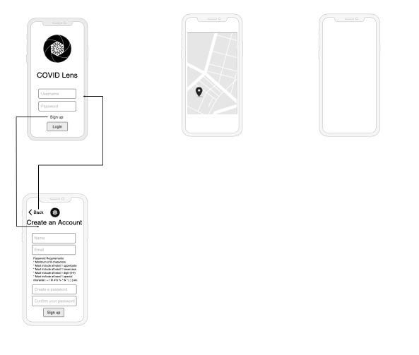
Draft Model
(In Progress)

